Slide 1
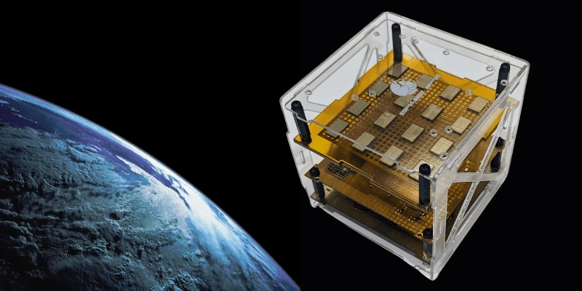
THE CUBE SAT
-PROJECT BY
SANTHOSH S
BALAMURALI V B
PRANAV MARIMUTHU

Slide 2
OUTLINE
Introduction
An overview of Cube-sat
Size comparison
Basic requirements of building a satellite
Structure
Antenna
Power
Computing
Observation of Venus

Slide 3
INTRODUCTION TO SATELLITES
A satellite is an object that orbits a larger body, such as a planet or a moon. In the context of space, satellites can be either natural (like the Moon orbiting Earth) or artificial (man-made devices launched into orbit for various purposes)
PROS OF CONFINING SATELLITES
*DATA EFFICIENCY
*COST REDUCTION
*FLEXIBILITY AND MODULARITY
*REDUCTION IN SPACE DEBRIS
*COLLABORATION AND ACCESSIBILITY

Slide 4
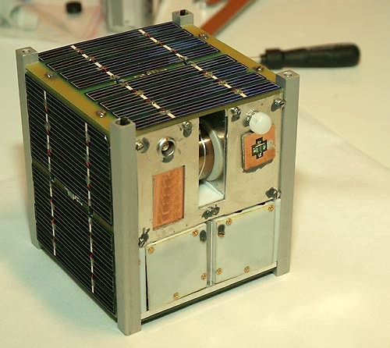
CUBE SATELLITES (CUBE SAT)
NEED
THE NEED FOR CUBE SATELLITES IS DRIVEN BY THEIR COST-EFFECTIVENESS, VERSATILITY, AND THE ABILITY TO RAPIDLY ADDRESS EMERGING CHALLENGES IN SCIENCE, TECHNOLOGY, AND COMMUNICATION. THEY PLAY A CRUCIAL ROLE IN DEMOCRATIZING ACCESS TO SPACE AND FOSTERING INNOVATION ACROSS VARIOUS SECTORS
DESIGN AND SPEC
PROVIDED DIMENSIONS :15cmX15cmX15cm
WEIGHT : LESS THAN OR EQUAL TO 1KG
FOR A BALANCED ARCHITECTURE THE FOLLOWING SHOULD BE ENSURED
*USAGE OF SUBSYSTEMS
*PAYLOAD
*STRUCTURAL DESIGN
*LAUNCH AND DEPLOYMENT
*END OF LIFE CONSIDERATION

Slide 5
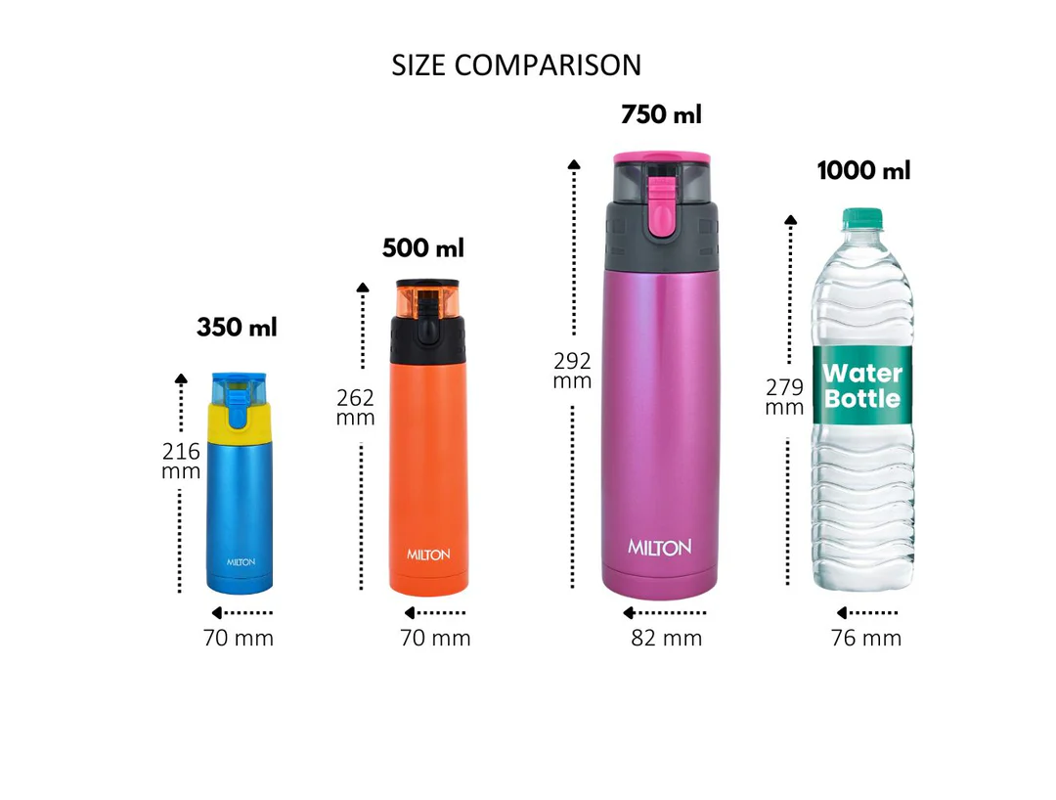
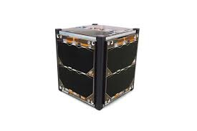
15CM
15CM
15CM

Slide 6
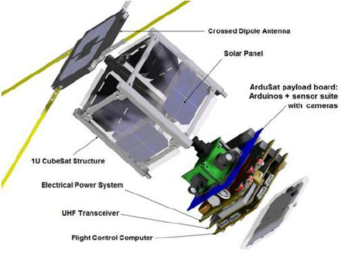
POWER SYSTEM
COMMUNICATION SYSTEM
ONBOARD COMPUTING
SUBSYSTEMS
ATTITUDE CONTROL
THERMAL CONTROL
The most common material used in CubeSat structure is Aluminium

Slide 7
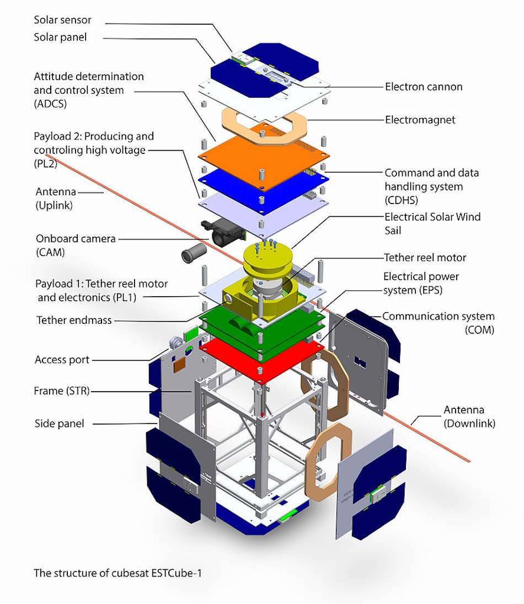

Slide 8
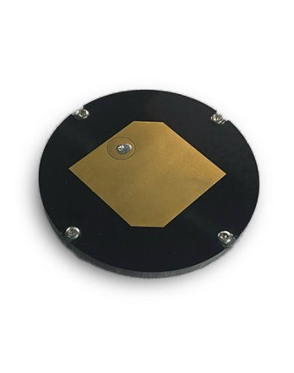
ANTENNA
FOR COMMUNICATION WE ARE USING A S-BAND ANTENNA.
THOUGH IT IS NOT AS EFFECTIVE AS HIGH-GAIN ANTENNAS IT IS SUFFICIENT FOR OUR MISSION.
S-BAND ANTENNA IS SELECTED FOR 2 REASONS:
1.CUBESAT HAS LIMITED POWER SUPPLY.
2.DATA REQUREMENTS ARE MODERATE AND WE ARE NOT COLLECTING HUGE AMOUNT OF DATA.

Slide 9
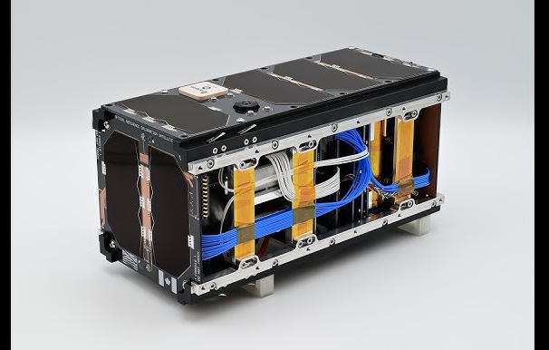
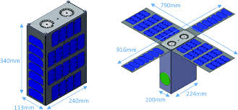
POWER
CUBESAT USES SOLAR CELLS TO CONVERT SOLAR LIGHT TO ELECTRICITY, THIS IS THEN STORED IN RECHARGEABLE LITHIUM-ION BATTERIES THAT PROVIDE POWER DURING ECLIPSE AS WELL AS DURING PEAK LOAD.
LITHIUM-ION BATTERIES FEATURE HIGH ENERGY-TO-MASS RATIO.

Slide 10
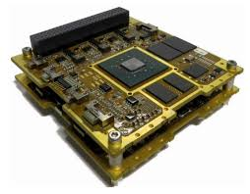
COMPUTING
COMPUTING IN A CUBESAT IS A CRITICAL ASPECT THAT INFLUENCES ITS OVERALL PERFORMANCE, FUNCTIONALITY, AND MISSION SUCCESS. HERE ARE THE MAIN COMPONENTS AND CONSIDERATIONS RELATED TO COMPUTING IN CUBESAT:
1.ONBOARD COMPUTER
2.SOFTWARE
3.DATAHANDLING
4.POWER MANAGEMENT
5.COMMUNICATION SYSTEM
6. FAULT TOLERANCE AND REDUNDANCY
7. REAL-TIME DATA PROCESSING
8.DEVELOPMENT CHALLANGES

Slide 11
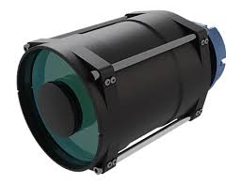
OBSERVATION OF VENUS
TO OBSERVE VENUS'S ATMOSPHERE WE ARE USING AN ONBOARD CAMERA WHICH CAPTURES IMAGES IN MULTIPLE WAVELENGTHS, THIS CAN BE USED TO OBSERVE CLOUD STRUCTURES, STUDY CHEMICAL COMPOSITIONS AND MONITOR WEATHER PATTERS.
THIS CAMERA IS A MULTISPECRAL CAMERA SPECIFICALLY USED FOR CUBESATS.
WE CAN USE THIS CAMERA TO OBSERVE VENUS'S ATMOSPHERE.

